Slide 1
1.2.1 – File Editing

Slide 2
Text Editing
Text editing is an important skill when using a Linux system
Whether changing a configuration file or writing a script, having a grasp on more than one text editor in Linux will be valuable
The text editors shown in this lesson are:
nano
vi(m)
These text editors require different levels of skill, but both have solid features

Slide 3
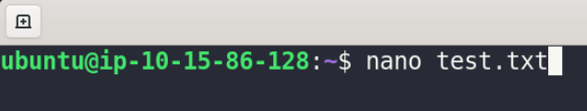
Nano Editor
Nano is the more user-friendly of the two editors
In a terminal, type nano and the name of the file to create to start using this editor
Similar to other word-processing applications in that you can immediately begin typing without commands
Comes with its own shortcuts and lists them on the bottom of the editor so that you don’t have to remember them

Slide 4
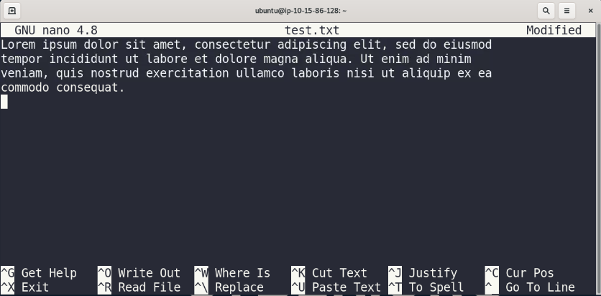
Nano Editor Anatomy
Title Bar
Main Body
Shortcut List
Status Bar

Slide 5
Nano Shortcuts
Shortcut | Alternative Keys | Description
Ctrl + G | F1 | Get Help, displays a help text box
Ctrl + X | F2 | Close the current buffer / Exit from nano (Nano then asks if you want to save with a Y or N option)
Ctrl + O | F3 | Write the current buffer (or marked region) to disk / Save
Ctrl + R | Ins | Insert another file into the current buffer (or into a new buffer)
Ctrl + W | F6 | Search forward for a string or regular expression
Ctrl + \ | M-R* | Replace a string or regular expression
Ctrl + K | F9 | Cut current line (or marked region) / Like Ctrl + X in word processing
Ctrl + U | F10 | Paste the contents of cutbuffer / Like Ctrl + V in word processing
Ctrl + J | F4 | Justify the current paragraph
Ctrl + T | F12 | Invoke the spell checker, if available
Ctrl + C | F11 | Display the position of the cursor
Ctrl + _ | M-G* | Go to line and column number
Notice the alternative keys for Replace and Go To Line are M-R and M-G. The M represents Esc or Alt or the Meta key on your keyboard depending on how it is set up. On the CYBER.ORG Range, that M would stand for Alt. So, those commands would look like Alt + R and Alt + G.

Slide 6
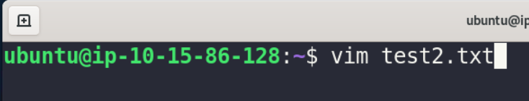
Vi or Vim Editor
When you are ready for a more frustrating… uh, powerful text editing experience, vi(m) editor is the choice for you.
As the previous line suggest, vi(m) editor is not novice friendly. But since you can’t get at something until you try it, let’s look at vi(m).
Vi(m) is the more popular editor for scripting and programming.
Just like with nano, to use this editor you type vi (or vim depending on the distribution) and then the name of the file.

Slide 7
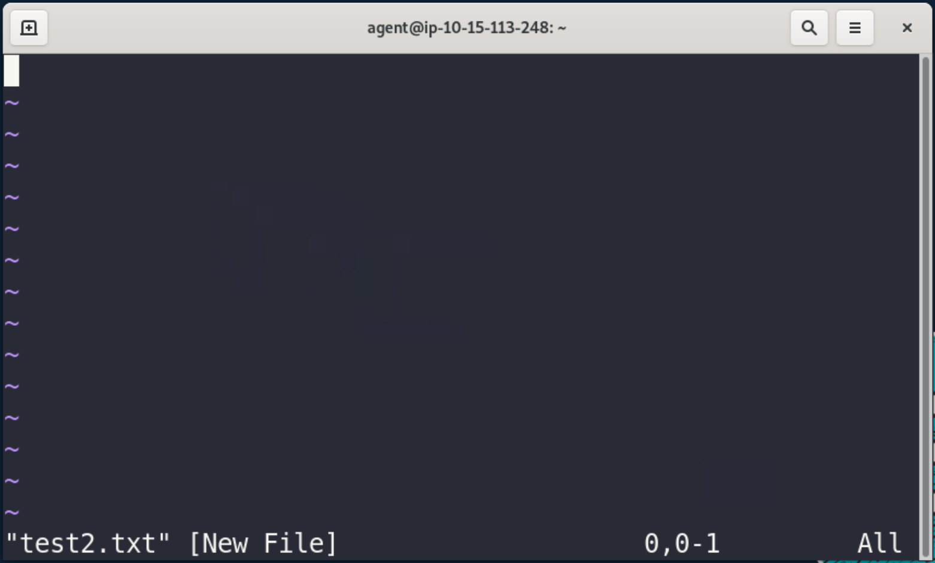
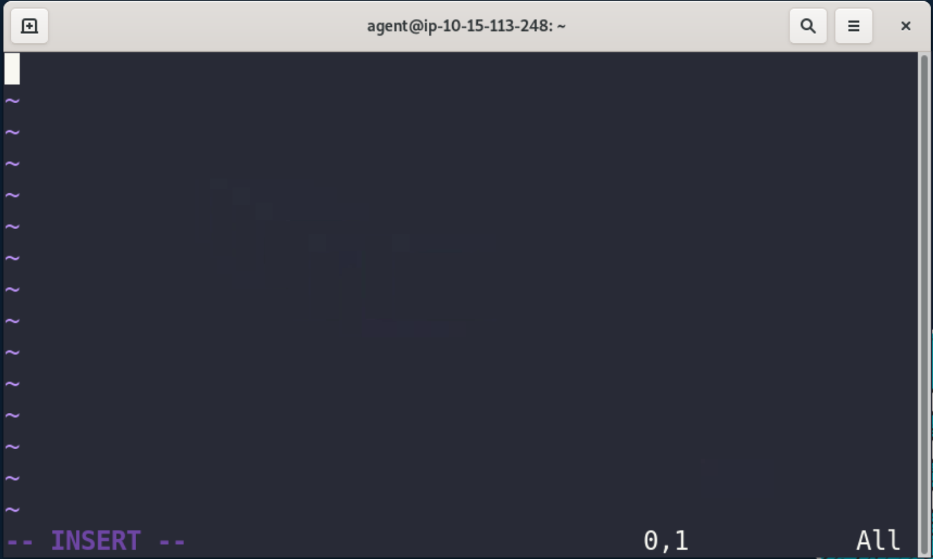
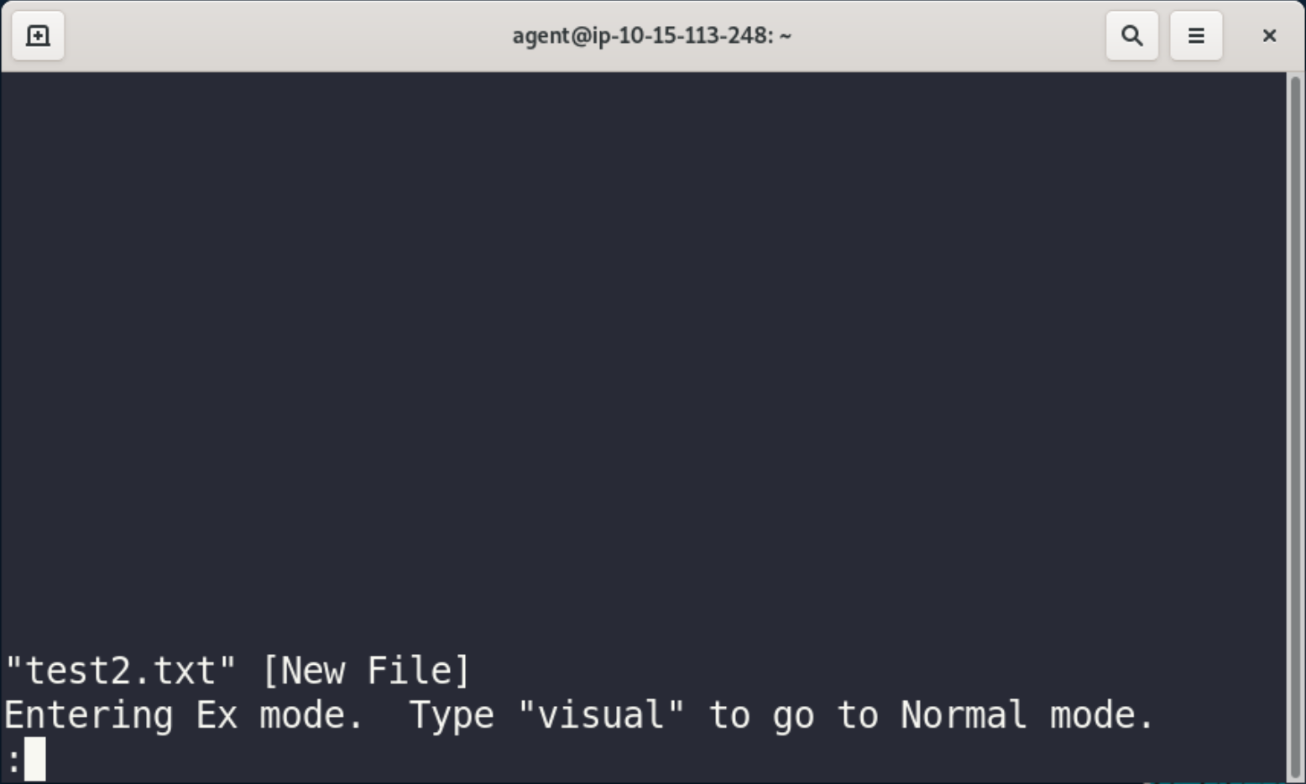

The Three Modes Vi or Vim Editor
Command Mode – Sometimes called normal mode, this is how vi(m) looks when first opened. It will only accept commands. Some common commands will be listed on the next slide.
Insert Mode – By pressing i on the keyboard, you’ll notice the word INSERT at the bottom of the screen. This means you are now able to enter text just in nano. Press Esc to switch back to command mode.
Ex Mode – This mode is sometimes called colon commands because commands here are preceded by a colon (:)

Slide 8
Vi(m) Shortcuts
Command Mode |  | Ex Mode (Colon Commands)
Keystroke | Description | Keystroke | Description
h | Move cursor left one character. | :x | Write buffer to file and quit editor.
l | Move cursor right one character. | :wq | Write buffer to file and quit editor.
j | Move cursor down one line. | :wq! | Write buffer to file and quit editor.
k | Move cursor up one line. | :w | Write buffer to file and stay in editor.
w | Move cursor forward one word to front of next | :w! | Write buffer to file and stay in editor.
e | Move cursor to end of current word. | :q | Quit editor without writing buffer to file.
b | Move cursor backward one word. | :q! | Quit editor without writing buffer to file.
^ | Move cursor to beginning of line.
$ | Move cursor to end of line.
gg | Move cursor to file’s first line.
G | Move cursor to file’s last line.
overrides protections
It is most popular to use Command Mode to navigate a file before entering text.

Slide 9
Stream Editors
Once files have been created, stream editors can change the way text looks on a standard output – the screen
Stream editors can range from simple to complex and range from changing words in text to helping sort large text outputs into more manageable chunks
The stream editors we will discuss are:
printf
sed
awk

Slide 10

printf
printf will show on the screen (your standard output) whatever you input into the command using the formatting you ask of it.
The printf command works like this: printf FORMAT [ARGUMENT]
So, with the command printf “%s\n” “Hello, World!”, let’s take a look at what we are asking the command to do.

Slide 11
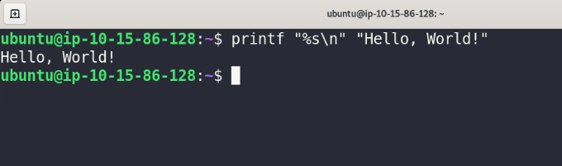
printf Format Options
Format | Description
%c | Display the first ARGUMENT character.
%d | Display the first ARGUMENT as a decimal integer number.
%f | Display the ARGUMENT as a floating-point number.
%s | Display the ARGUMENT as a character string.
\% | Display a percentage sign.
\” | Display a double quotation mark.
\\ | Display a backslash.
\f | Include a form feed character.
\n | Include a newline character.
\r | Include a carriage return.
\t | Include a horizontal tab.
It prints the string ‘Hello, World!’ and then puts the command line on a new line, of course!
Okay, so based on the chart, what will this command do?

Slide 12
sed
sed stands for stream editor
sed can be used on text files with one pass as the text “streams” through this utility
In that single pass, sed looks for patterns in the text as dictated by the user
The command looks like: sed [OPTIONS] [SCRIPT]… [FILENAME]
Much like the printf command, sed can very simply print text to the screen, but make changes according to requests

Slide 13
sed Commonly Used Options
When using sed with a file, we’ll need some options.
Here are the most common options.
Option i (-i) will actually save the changes we make with sed to the file we are using so that we don’t have to go back and do that later.
Short | Long | Description
-e script | --expression=script | Add commands in script to text processing. The script is written as part of the sed command.
-f script | --file=script | Add commands in script to text processing. The script is a file.
-r | --regexp-extended | Use extended regular expressions in script.
-i | --in-place | Edits file in place.

Slide 14
awk
sed and awk have a lot in common in the way they can change text
awk is more powerful since it is a programming language for completing formatted reports for large data sets
A big difference is that awk treats each item separated by a space as a separate field
The command looks like: awk [OPTIONS] [PROGRAM]… [FILENAME]
awk comes in a variety of versions. When GNU project rewrote it, it became gawk. Either way you type it, many distribution will still put from gawk

Slide 15


awk Commonly Used Options
Short | Long | Description
-F d | --field-separator d | Specify the delimiter that separates the data file’s fields
-f file | --file=file | Use program in file for text processing.
-s | --sandbox | Execute awk program in sandbox mode.
Option F (-F) allows us to tell awk what the delimiter will be that separates fields.
If we wanted to print just the users in the /etc/shadow file for instance, we would want to indicate that the delimiter of that file is the : (colon) between each field.

